Slide 1

Fundamentals of Digital Logic Circuits
Module 3
Topic: Karnaugh Map (K-Map)
Dr.M.RAMESH
Assistant Professor
Dept of EECE
GIT,GITAM
Email id:rmanikon@gitam.edu

Slide 2
FDLC Module 3
Gate-Level Minimization: The K-Map method, Two variable K-Map,
Three variable K-Map, Four variable K-Map, Five variable K-Map,
Six variable K-Map, K-Maps with don’t care conditions
(incompletely specified functions), Tabular method for minimization
(Quine McCluskey Method), Sum of products (SOP)
and Product of sums (POS) simplification.

Slide 3
Karnaugh maps (K-maps) are graphical representations of Boolean functions.
One map cell corresponds to a row in the truth table.
Also, one map cell corresponds to a minterm or a maxterm in the Boolean expression
Multiple-cell areas of the map correspond to standard terms.
A K-map provides a systematic method for simplifying Boolean expressions and, if properly used, will produce the simplest SOP or POS expression possible, known as the minimum expression.

Slide 4
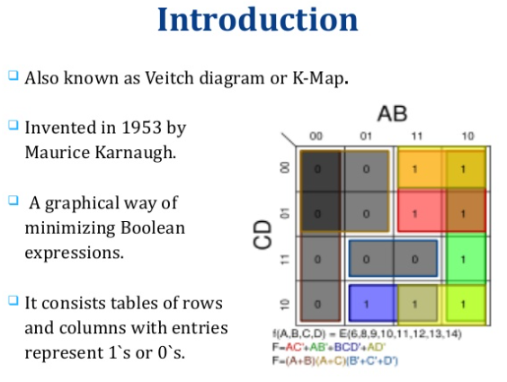

Slide 5
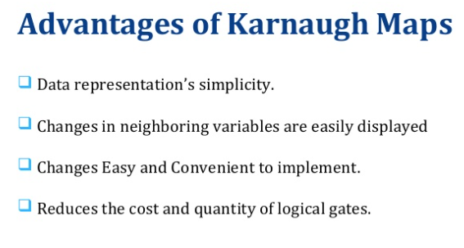

Slide 6
Rules for K-Map Simplification
1)Groups may not contain zero
2)We can group 1,2,4,8 or 2^n Cells
3)Each group should be as large as possible
4)Cells containing 1 must be grouped
5) Groups may overlap
6)Opposite grouping and corner grouping is allowed
7)There should be as few groups as possible

Slide 7
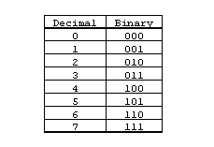
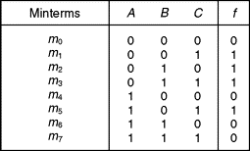

Slide 8
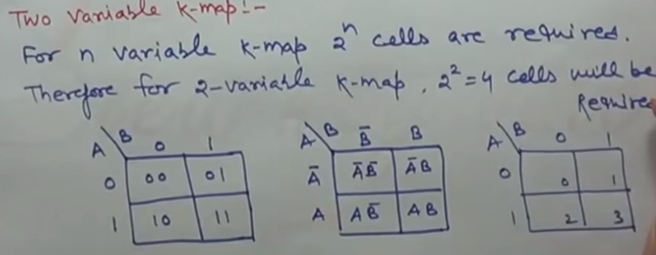
K-map is a graphical representation that provides a systematic method
for simplifying Boolean expression.

Slide 9


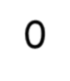
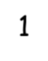
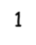
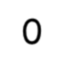
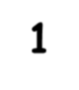
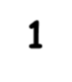

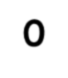
2-Variable Map -- Example
f(x₁,x₂) = x₁’x₂’+ x₁’x₂ + x₁x₂’
= m₀ + m₁ + m₂
= x₁’ + x₂’
1s placed in K-map for specified min-terms m₀,m₁, m₂
x
x₁ 0
2
1
0 |  |  | 1
 |  | 1 | 1
2 |  | 1 | 3 0
0
1

Slide 10
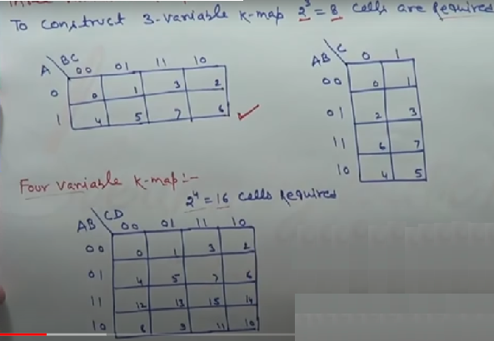

Slide 11









The 3 Variable K-Map
There are 8 cells as shown:
C
AB
00
0 1
ABC | ABC
ABC | ABC
ABC | ABC
ABC | ABC
01
11
10

Slide 12

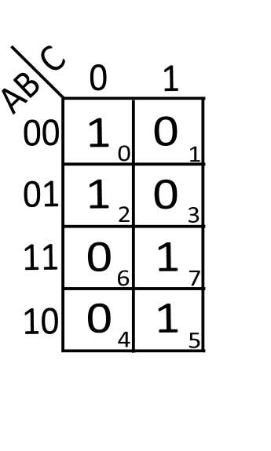
Example 3 var. k-map
M_in_im_ iz_e t_he following equation using k-map
y=A’B’C+A’BC’+AB’C+ABC
‘
A'B'C' = 000 =0
A'BC' = 101 = 5
AB'C = 010 = 2
ABC = 111 = 7
Grouping – here 2 groups of 2 1’s is possible
F=A’C’+AC

Slide 13
For upper group A and C are constants and B is varying. Neglect B.
A and C both are 0. Hence output of this group is AC
For upper group A and C are constants and B is varying. Neglect B.A and C both are 0. Hence output of this group is AC
Thus output Y is given by ,
Y-A’C’+AC

Slide 14
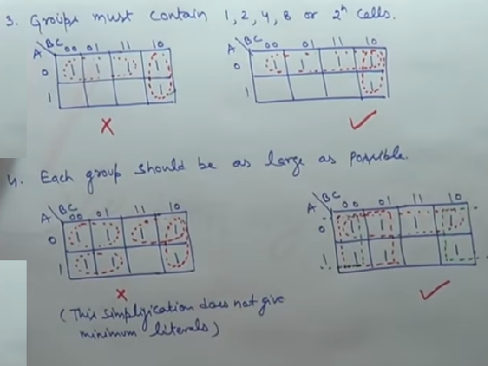

Slide 15

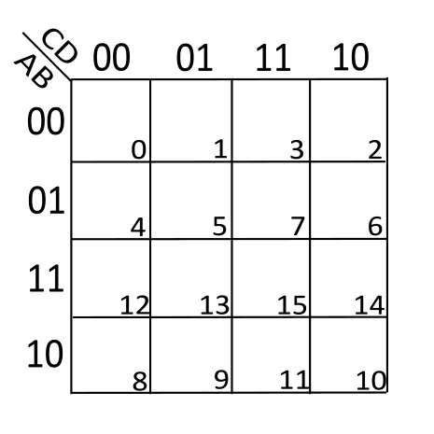










The 4-Variable K-Map
CD AB
00
01
11
10
00
01
11
10
ABCD | ABCD | ABCD | ABCD
ABCD | ABCD | ABCD | ABCD
ABCD | ABC D | ABCD | ABCD
ABCD | ABCD | ABCD | ABCD

Slide 16







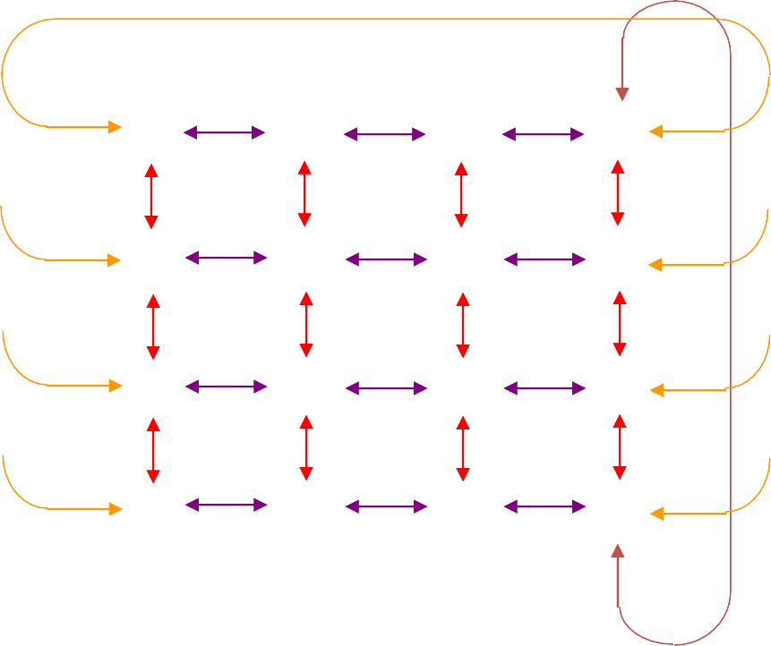




Cell Adjacency
CD AB
00
01
11
10
00 01 11 10

Slide 17
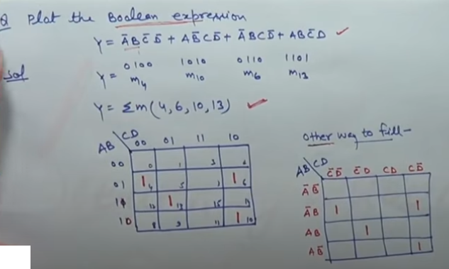

Slide 18
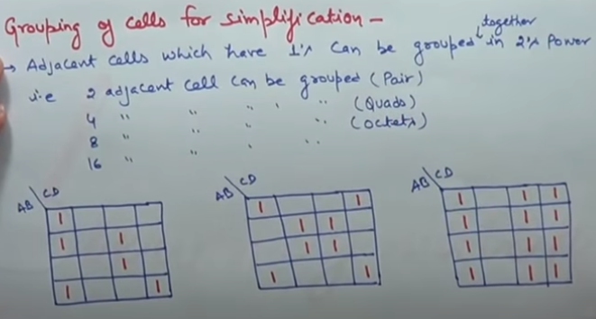

Slide 19
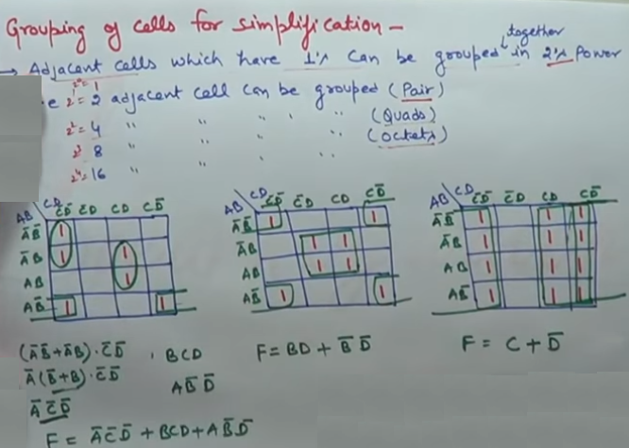

Slide 20

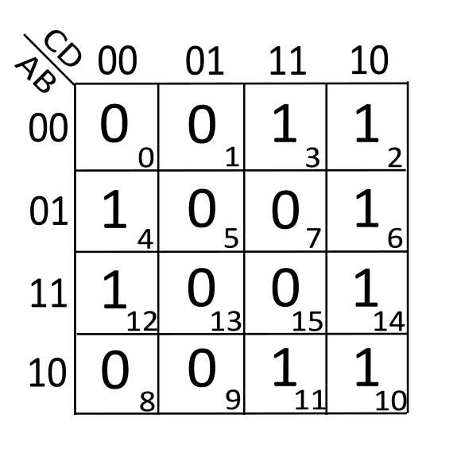
Solve the given k-map
Step I -grouping
Step II -output of each group
Step III -final output
Here answer is ,
_ _ _ Y=CD+BC+BD

Slide 21
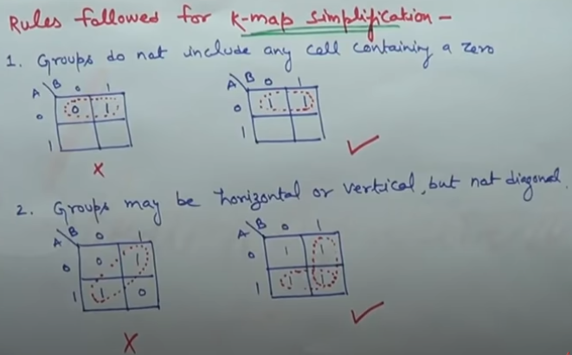

Slide 22
K-Map SOP Minimization
The K-Map is used for simplifying Boolean expressions to their minimal form.
A minimized SOP expression contains the fewest possible terms with fewest possible variables per term.
Generally, a minimum SOP expression can be implemented with fewer logic gates than a standard expression.

Slide 23
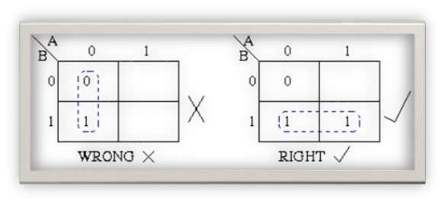
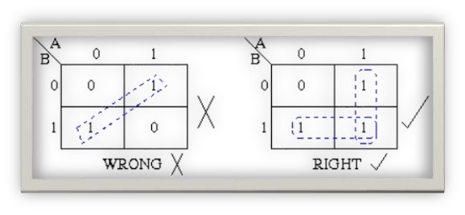
Rules of grouping -
1’s & 0’s can not be grouped
Diagonal 1’s can not be grouped

Slide 24

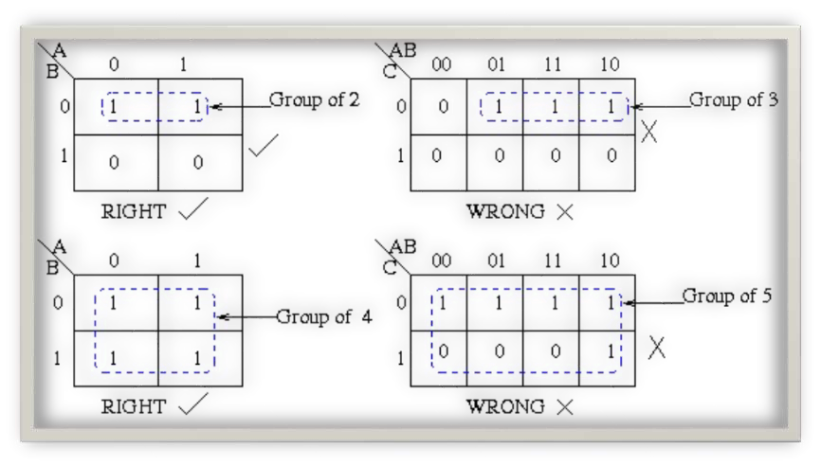
Elements in a group should be 2^{n}

Slide 25
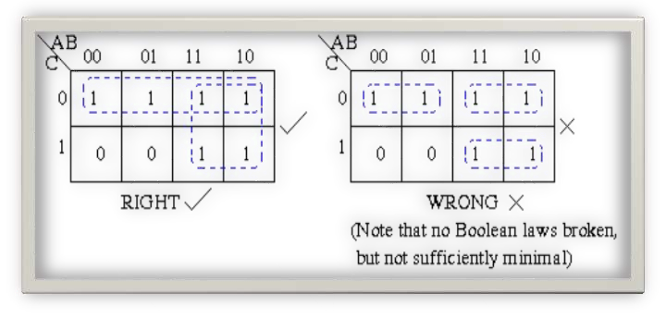
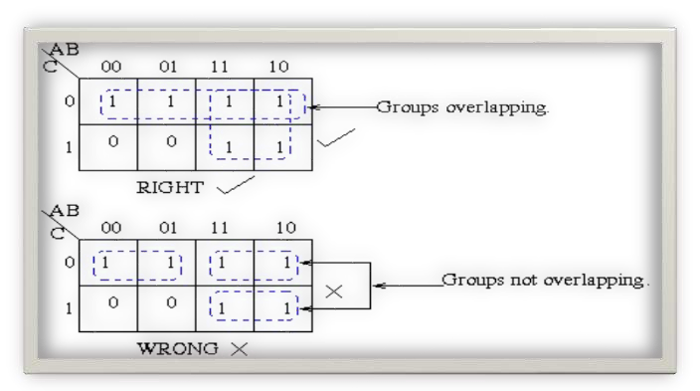
Minimum Groups should be formed
For above rule group Overlapping is applicable

Slide 26
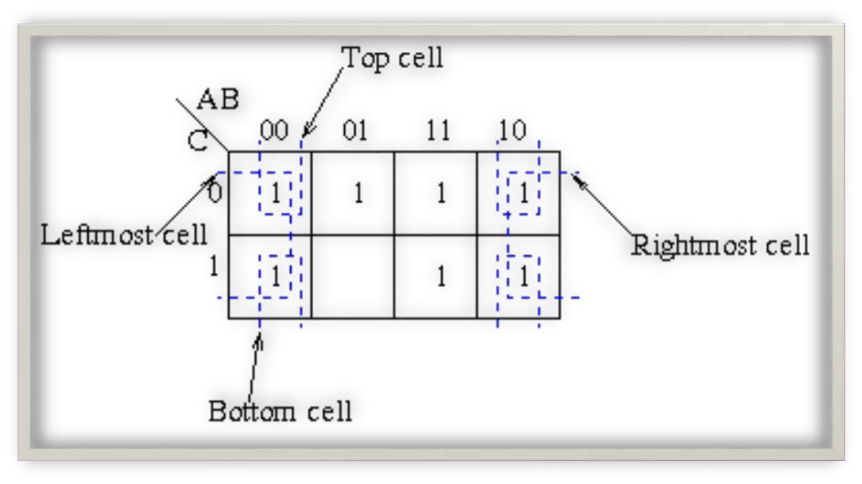

Slide 27

Three-Variable K-Maps
f = ∑ (0,4) = B C
f = ∑ (4,5) = A B
f = ∑ (0,1,4,5)= B
f = ∑ (0,1,2,3)= A
BC
_{A} 00 01 11 10
BC
_{A} 00 01 11 10
BC
_{A} 00 01 11 10
BC
_{A} 00 01 11 10
0
1
1 | 0 | 0 | 0
1 | 0 | 0 | 0
0
1
0 | 0 | 0 | 0
1 | 1 | 0 | 0
0
1
1 | 1 | 0 | 0
1 | 1 | 0 | 0
0
1
1 | 1 | 1 | 1
0 | 0 | 0 | 0
f = ∑ (0,4) = A C
f = ∑(4,6) = A C
f = ∑ (0,2) = A C
f = ∑ (0,2,4,6)= C
BC
_{A} 00 01 11 10
BC
_{A} 00 01 11 10
BC
_{A} 00 01 11 10
BC
_{A} 00 01 11 10
0
1
0 | 1 | 1 | 0
0 | 0 | 0 | 0
0
1
0 | 0 | 0 | 0
1 | 0 | 0 | 1
0
1
1 | 0 | 0 | 1
0 | 0 | 0 | 0
0
1
1 | 0 | 0 | 1
1 | 0 | 0 | 1

Slide 28
Four-Variable K-Maps
CD
CD
CD
CD
AB
00
01
11
10
00 01 11 10
AB
00
01
11
10
00 01 11 10
AB
00
01
11
10
00 01 11 10
AB
00
01
11
10
00 01 11 10
1 | 0 | 0 | 0
0 | 0 | 0 | 0
0 | 0 | 0 | 0
1 | 0 | 0 | 0
0 | 0 | 0 | 0
0 | 1 | 0 | 0
0 | 1 | 0 | 0
0 | 0 | 0 | 0
0 | 0 | 0 | 0
0 | 0 | 0 | 0
0 | 1 | 1 | 0
0 | 0 | 0 | 0
0 | 0 | 0 | 0
1 | 0 | 0 | 1
0 | 0 | 0 | 0
0 | 0 | 0 | 0
f = ∑(0,8) = B • C • D
f = ∑ (5,13) = B• C • D
f = ∑ (13,15)= A • B• D
f = ∑ (4,6) = A • B• D
CD
CD
CD
CD
AB
00
01
11
10
00 01 11 10
AB
00
01
11
10
00 01 11 10
AB
00
01
11
10
00 01 11 10
AB
00
01
11
10
00 01 11 10
0 | 0 | 1 | 1
0 | 0 | 1 | 1
0 | 0 | 0 | 0
0 | 0 | 0 | 0
0 | 0 | 0 | 0
1 | 0 | 0 | 1
1 | 0 | 0 | 1
0 | 0 | 0 | 0
0 | 0 | 1 | 1
0 | 0 | 0 | 0
0 | 0 | 0 | 0
0 | 0 | 1 | 1
1 | 0 | 0 | 1
0 | 0 | 0 | 0
0 | 0 | 0 | 0
1 | 0 | 0 | 1
f = ∑ (2,3,6,7)= A • C
f = ∑ (4,6,12,14) = B• D
f = ∑ (2,3,10,11) = B • C
f = ∑ (0,2,8,10)= B • D

Slide 29

Four-Variable K-Maps
CD
CD
CD
CD
AB
00
01
11
10
00 01 11 10
AB
00
01
11
10
00 01 11 10
AB
00
01
11
10
00 01 11 10
AB
00
01
11
10
00 01 11 10
0 | 0 | 0 | 0
1 | 1 | 1 | 1
0 | 0 | 0 | 0
0 | 0 | 0 | 0
0 | 0 | 1 | 0
0 | 0 | 1 | 0
0 | 0 | 1 | 0
0 | 0 | 1 | 0
1 | 0 | 1 | 0
0 | 1 | 0 | 1
1 | 0 | 1 | 0
0 | 1 | 0 | 1
0 | 1 | 0 | 1
1 | 0 | 1 | 0
0 | 1 | 0 | 1
1 | 0 | 1 | 0
f = ∑ (0, 3, 5, 6, 9,10,12,15)
f = A ⊗ B ⊗ C ⊗ D
f = ∑ (1, 2, 4, 7,8,11,13,14)
f = A ⊕ B ⊕ C ⊕ D
f = ∑ (4, 5, 6, 7) = A • B
f = ∑(3, 7,11,15) = C• D
CD
CD
CD
CD
AB
00
01
11
10
00 01 11 10
AB
00
01
11
10
00 01 11 10
AB
00
01
11
10
00 01 11 10
AB
00
01
11
10
00 01 11 10
0 | 1 | 1 | 0
0 | 1 | 1 | 0
0 | 1 | 1 | 0
0 | 1 | 1 | 0
1 | 0 | 0 | 1
1 | 0 | 0 | 1
1 | 0 | 0 | 1
1 | 0 | 0 | 1
0 | 0 | 0 | 0
1 | 1 | 1 | 1
1 | 1 | 1 | 1
0 | 0 | 0 | 0
1 | 1 | 1 | 1
0 | 0 | 0 | 0
0 | 0 | 0 | 0
1 | 1 | 1 | 1
f = ∑(1, 3,5, 7, 9,11,13,15)
f = D
f = ∑ (0,2,4,6,8,10,12,14)
f = D
f = ∑ (4,5,6,7,12,13,14,15)
f = B
f = ∑ (0,1,2,3,8,9,10,11)
f = B

Slide 30






















Determining the Minimum SOP Expression from the Map
CD AB
B + AC + ACD
00 01 11 10
00 |  |  | 1 | 1
01 | 1 | 1 | 1 | 1
11 | 1 | 1 | 1 | 1
10 |  | 1
AC
B
ACD

Slide 31


























Determining the Minimum SOP Expression from the Map
C
C
AB
00
01
11
10
0
1
0
1
AB
00
01
11
10
1
 | 1
1 | 1
1 | 1
1
 | 1
1 | 1
AB + BC + ABC
B + AC + AC

Slide 32






















Mapping Directly from a Truth Table
Y=AC’+AB+B’C’
I/P |  |  | O/P
A | B | C | X
0 | 0 | 0 | 1
0 | 0 | 1 | 0
0 | 1 | 0 | 0
0 | 1 | 1 | 0
1 | 0 | 0 | 1
1 | 0 | 1 | 0
1 | 1 | 0 | 1
1 | 1 | 1 | 1
C
AB
00
0
1
1
01
11
1
1
10
1

Slide 33
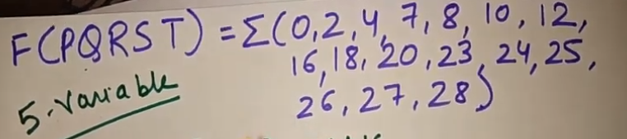
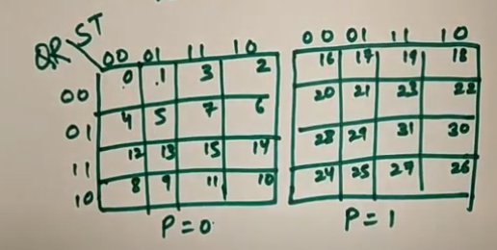

Slide 34
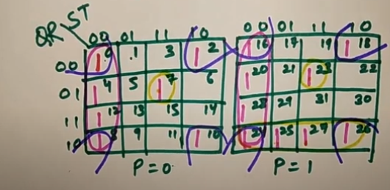
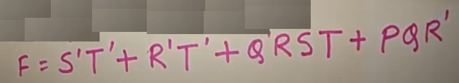

Slide 35
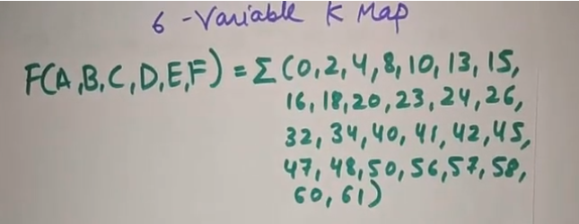

Slide 36
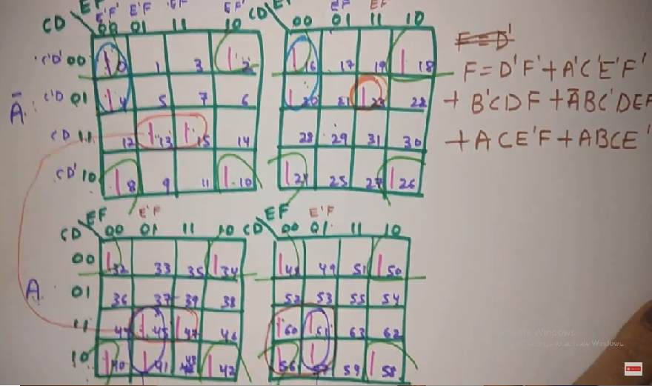

Slide 37
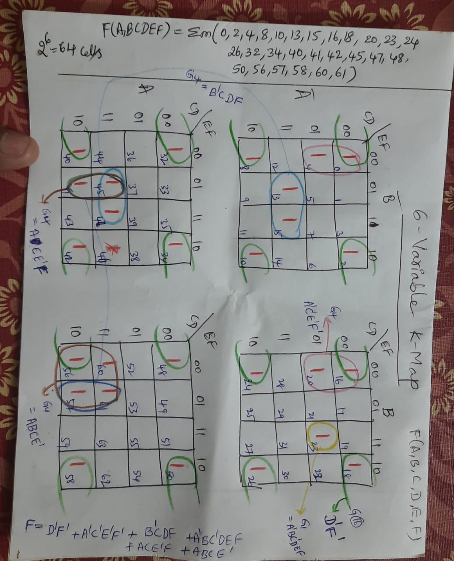

Slide 38
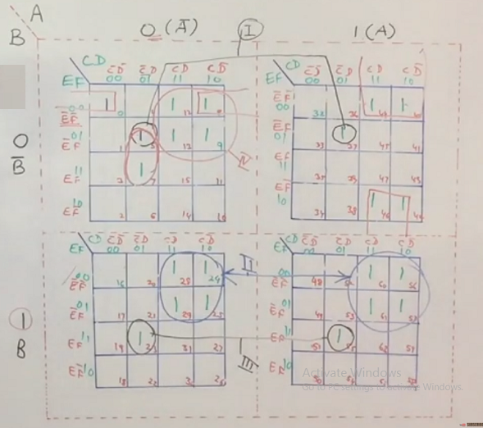

Slide 39


Slide 40
DON’T CARE CONDITIONS (1/4)
In some situations, we don’t care about the value of a function for certain combinations of the variables.
these combinations may be impossible in certain contexts.
or the value of the function may not matter in when the combinations occur.

Slide 41
DON’T CARE CONDITIONS (2/4)
In such situations we say the function is incompletely specified and there are multiple (completely specified) logic functions that can be used in the design.
so we can select a function that gives the simplest circuit.

Slide 42

DON’T CARE CONDITIONS (3/4)
When constructing the terms in the simplification procedure, we can choose to either cover or not cover the don’t care conditions.
To distinguish the don’t care conditions from 1’s and 0’s , an X will be used.

Slide 43
DON’T CARE CONDITIONS (4/4)
Don’t care conditions are part of function
specification.
f = ∑m(.....)+ ∑d(.....)
f = ∏M (.....)∏D(.....)
They can be used for both sum-of-product and product-of-sum forms of functions.

Slide 44
EXAMPLES OF DON’T CARE CONDITIONS (1/2)
BC
A 00 01 11 10
F = ∑m(1, 3, 7) + ∑d(0, 5)
0 X | 1 1 | 3 1 | 2
4 | 5 X | 7 1 | 6
Circle the x’s that help get bigger groups of 1’s (or 0’s if POS).
Don’t circle the x’s that don’t help.
0
1
Reduced form :F =C

Slide 45
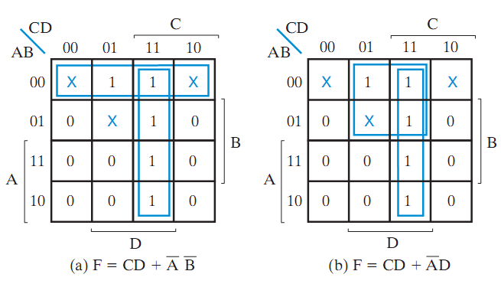
EXAMPLES OF DON’T CARE CONDITIONS (2/2)
F(A, B, C, D) = ∑ m(1, 3, 7, 11, 15) + ∑ d(0, 2, 5)
Two possible solutions , both are acceptable.

Slide 46
K-MAP SIMPLIFICATION
USING DON’T CARE CONDITIONS
Functions that have unspecified output for some input combinations are called incompletely specified functions.
We simply don’t care whether the value of 0 or 1 is assigned to F for a particular minterm.
Don’t care conditions are represented by X in the K-Map variable.

Slide 47
EXAMPLES OF K-MAP
USING DON’T CARE CONDITIONS (1/2)
AB
A
00
01
11
10
0 |  | 0 | X | 0
 | 1 | 1 | X | 1
1 |  | 1 | 0 | 0
0 |  | X | 0 | 0
F=A’D+C’D
C
B
fC(DA,B,0C0,D0)1 =1 1 Σm1 0(1,3,5,7,9)_{R}+_{ed}d_{u}(_{c}6_{e},1_{d}2,_{f}1_{o}3_{r})_{m:}

Slide 48
f(A,B,C,D) = Σm(1,6,10,11,12,13,15) + d(4,5,7,8,14)
CD
AB
00 01 11 10
00 0 1 0 0
01 x x x 1
F=A′C′D+B+AC
11 1 1 1 x
10 x 0 1 1

Slide 49
SEVEN SEGMENT DISPLAY
WITH DON’T CARE
In digits 0-9, inputs A-F are don’t care.
They can be specified accordingly.
This fact can be used to simplify function.

Slide 50
SEVEN SEGMENT DISPLAY
WITH DON’T CARE
a
f
b
g
e
c
d

Slide 51

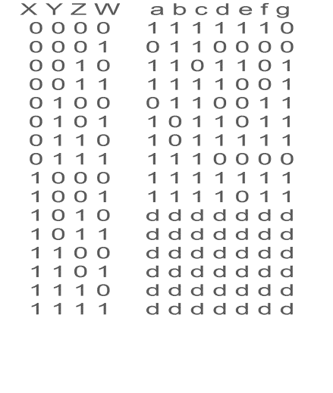

Slide 52


